Slide 1
Witches brew
SCIENCE SATURDAY

Slide 2
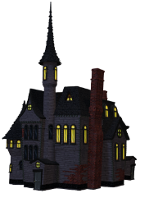
The Science Behind Witches Brew
Chemistry is all about states of matter including liquids, solids, and gasses. A chemical reaction occurs between two or more substances that change and form a new substance, and in this case a gas called carbon dioxide. In this case, you have an acid (liquid: vinegar) and a base solid: baking soda) when combined make a gas called carbon dioxide.
You can see the carbon dioxide gas in the form of bubbles. You can even hear them if you listen closely.
The dish soap is added to collect the gas and form bubbles that give it a more robust potion like flow down the side!
Notes:
Science Activities For Kindergarten – 2021 Guide – Education Outside

Slide 3
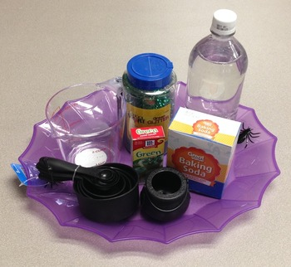
MATERIALS
Cauldrons
Baking Soda
Dish Soap
Vinegar
Food Coloring
Glitter

Slide 4
STEP 1
Add a teaspoon of baking soda into the cauldron!

Slide 5
STEP 2
Add a squirt of dish soap if you want a foamier eruption! The chemical eruption will produce frothier bubbles with the added dish soap and create more overflow too.

Slide 6
STEP 3
In a clear cup add a few drops of food coloring and vinegar. *You can let the kids choose a color for each of their cauldrons* So bring multiple cups.

Slide 7
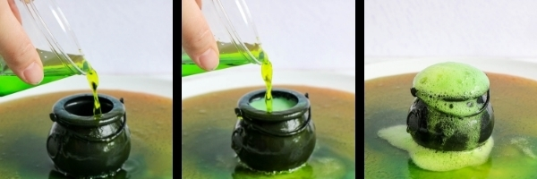
STEP 4
Time to add the vinegar/food color and observe the chemistry at work!

